Slide 1
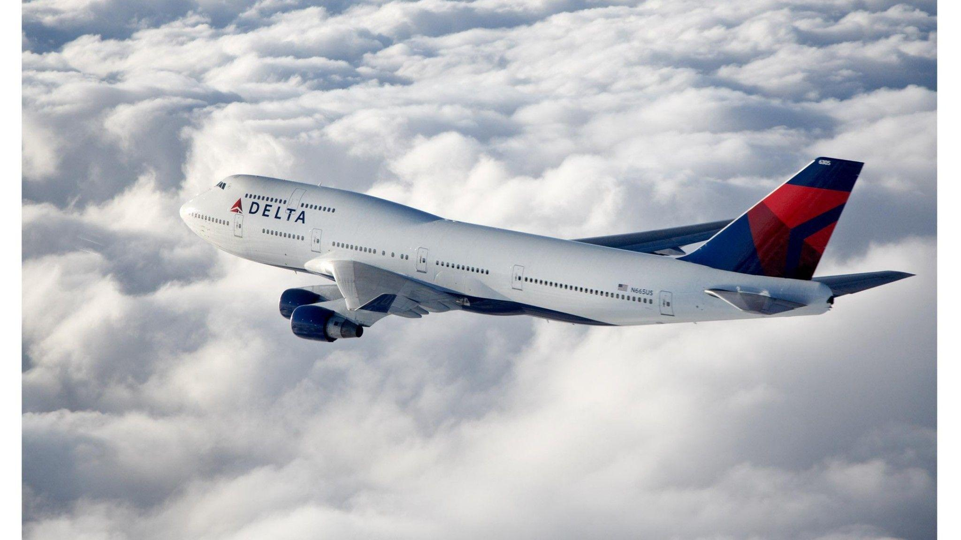
ECONOMIC IMPACT OF FLIGHT DELAYS FOR DELTA AIRLINES
Data Alchemists
Kyu K, Patrick W, Lydia Z, Angela G

Slide 2





OVERVIEW
MEET THE TEAM
Kyu Kim
MSBA Candidate
Angela Guevarra
MSBA Candidate
Patrick Wang
MSBA Candidate
Lydia Zhang
MSBA Candidate

Slide 3
OVERVIEW
TABLE OF CONTENTS
BUSINESS UNDERSTANDING
DATA UNDERSTANDING
DATA PREPARATION
MODELING
ECONOMIC IMPACT

Slide 4

1
BUSINESS UNDERSTANDING

Slide 5



BUSINESS UNDERSTANDING
Delayed Flights Leave a $40.46bn Dent in the Economy Annually
Customers
Increased expenses for crew
Airports and GDP
Airlines
Lost passenger time due to delays, cancellations and missed connections
Cost of forced rescheduling due to runway capacity limitations
Expenses for food & accommodations
Increased fuel costs
Increased time and expenses for maintenance
Reducing productivity in other sectors
Annual Impact on Economy
Cost Component | Cost (in billions) *Inflation Adjusted (+23%)*
Customers | $20.54
Airlines | $10.21
Airports / GDP | $4.92
Total | $40.46
BUSINESS UNDERSTANDING
DATA UNDERSTANDING
DATA PREPARATION
MODELING
ECONOMIC IMPACT
Source: UC Berkeley

Slide 6





BUSINESS UNDERSTANDING
Delta’s Winning Strategy and the Post-Pandemic Situation
Four Key Operational Activities
Delta Airlines Key Stats
$25.85 bn valuation
$47.01 bn revenue
15% market share in US
Largest airline in the world by revenue, assets and market capitalization
Main customers are business travelers
Purchasing Used
Planes
Industry Leading
Customer Service
Vertical Integration
Low Unionization
Rates
COVID-19 and Shifting Customer Expectations
Revenues dropped from $47bn to $18bn and is operating on a negative EBIT
Became world’s third largest airline after China Southern and United Airlines
Shift in business traveler expectations to video calls
Reluctancy for travel due to new restrictions (80% vs to pre-pandemic)
BUSINESS UNDERSTANDING
DATA UNDERSTANDING
DATA PREPARATION
MODELING
ECONOMIC IMPACT
Source: HBS, UC Berkeley

Slide 7
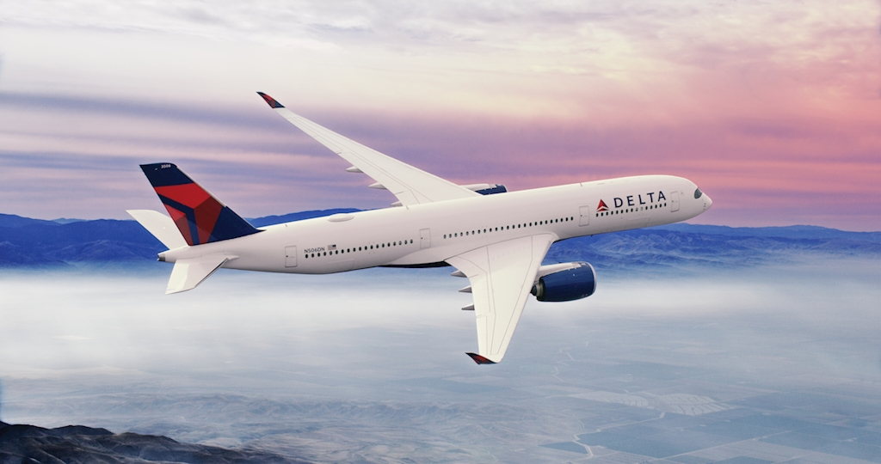
2
DATA UNDERSTANDING

Slide 8


DATA UNDERSTANDING
Data Composition
Flight Status Data
ATL Weather Data
Source: Bureau of Transportation
All domestic flights' status from 2017-2019
Size: 15.3M data points, 9 features
Date, carrier, flight number (route), tail number, origin, destination, departure time block, minutes delayed (for departure), & elapsed time
Source: National Oceanic Atmospheric Administration
791 days, 16 features
date, snow, precipitation, max/min/average temperature, fog, thunder, tornado, smoke/haze, etc.
BUSINESS UNDERSTANDING
DATA UNDERSTANDING
DATA PREPARATION
MODELING
ECONOMIC IMPACT
Notes:
Source: https://www.transtats.bts.gov/databases.asp?Z1qr_VQ=E&Z1qr_Qr5p=N8vn6v10&f7owrp6_VQF=D
https://www.ncdc.noaa.gov/cdo-web/datasets

Slide 9
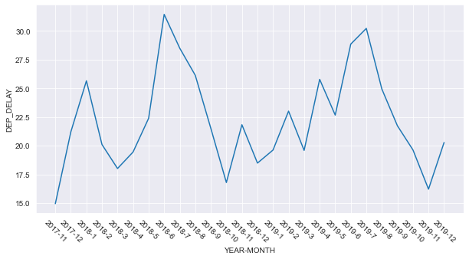
DATA UNDERSTANDING
Delta Airlines at Hartsfield-Jackson Atlanta Airport
Reasons for Selecting Delta at ATL
Year-Month Trend at ATL
Limited computational power requires a smaller dataset (including all airports and airlines creates 400+ dummies which caused problems for classification)
Using all airports and airlines gives over-generalized insights
Considering the "premium" image of Delta, it should have less delays
The hub of Delta is ATL
Delta at ATL has clear seasonality patterns
Ended up with 24K rows for training, 2K for testing
BUSINESS UNDERSTANDING
DATA UNDERSTANDING
DATA PREPARATION
MODELING
ECONOMIC IMPACT

Slide 10
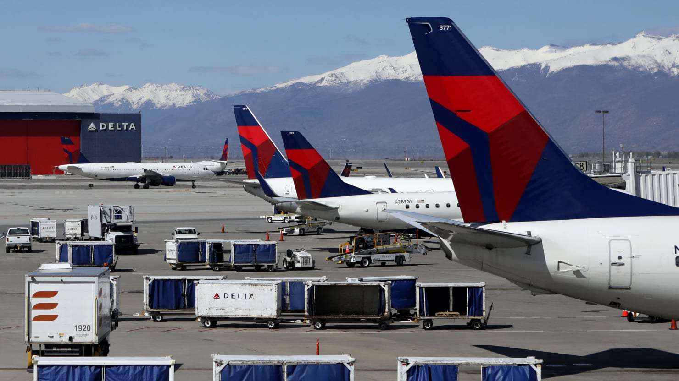
3
DATA PREPARATION

Slide 11
Data Preparation
Merging, Cleaning, Filtering
Merging
Cleaning
Filtering
Merged flight status data during 2017-2019 to analyze seasonality
Joined additional weather data with flight status data
Eliminated rows w/ missing values
Replaced carrier and airport codes with their full name to increase readability
Focused on Delta, ATL
Dropped features that are less significant on predicting delay such as indexes
BUSINESS UNDERSTANDING
DATA UNDERSTANDING
DATA PREPARATION
MODELING
ECONOMIC IMPACT

Slide 12



Data Preparation
Feature Engineering
Seasonality
Plane Age
Crowdedness
Create the features of year, month and day_of_week from the flight dates
Create the variable of plane age by using
(2019 – manufacturing year)
Create the feature of the number of flights that depart in the same time block of a day at the airport
BUSINESS UNDERSTANDING
DATA UNDERSTANDING
DATA PREPARATION
MODELING
ECONOMIC IMPACT

Slide 13
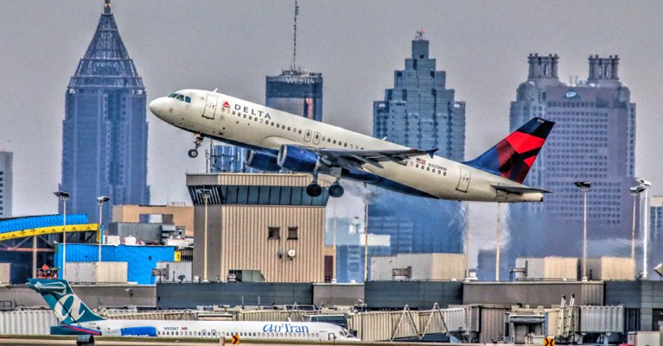
4
MODELING

Slide 14
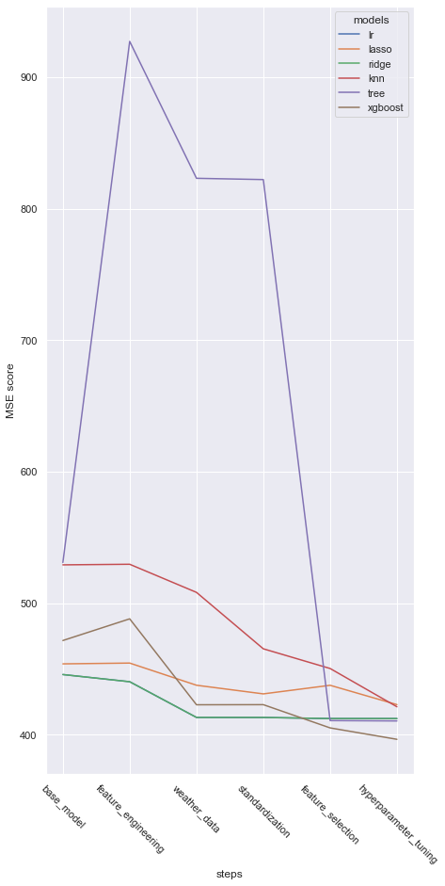
Modeling
Step 1: Base Model with Only Flight Status Information
FEATURES
DEP_TIME_BLK
CRS_ELAPSED_TIME
PERFORMANCE
LR | Lasso | Ridge | kNN | Tree | XGBoost
445.75 | 453.87 | 445.75 | 529.15 | 530.92 | 471.62
BUSINESS UNDERSTANDING
DATA UNDERSTANDING
DATA PREPARATION
MODELING
ECONOMIC IMPACT

Slide 15
Modeling
Step 2: Conducting Feature Engineering
FEATURES
DEP_TIME_BLK
CRS_ELAPSED_TIME
MONTH
DAY_OF_WEEK
DEP_TIME_BLK
NUMBER_OF_SEATS
PLANE_AGE
FLIGHT_BLK_NUM
PERFORMANCE
LR | Lasso | Ridge | kNN | Tree | XGBoost
440.29 | 454.47 | 440.28 | 529.60 | 927.21 | 488.10
BUSINESS UNDERSTANDING
DATA UNDERSTANDING
DATA PREPARATION
MODELING
ECONOMIC IMPACT

Slide 16
Modeling
Step 3: Adding in the Weather Information
FEATURES
DEP_TIME_BLK
CRS_ELAPSED_TIME
MONTH
DAY_OF_WEEK
DEP_TIME_BLK
NUMBER_OF_SEATS
PLANE_AGE
FLIGHT_BLK_NUM
WT01 WT02 WT03
WT04 WT05 WT08
AWND PRCP
SNOW SNWD
TAVG TMAX TMIN
WSF2 WSF5
PERFORMANCE
LR | Lasso | Ridge | kNN | Tree | XGBoost
413.13 | 437.61 | 413.14 | 508.22 | 823.09 | 422.76
BUSINESS UNDERSTANDING
DATA UNDERSTANDING
DATA PREPARATION
MODELING
ECONOMIC IMPACT

Slide 17
Modeling
Step 4: Standardizing Our Dataset
FEATURES
DEP_TIME_BLK
CRS_ELAPSED_TIME
MONTH
DAY_OF_WEEK
DEP_TIME_BLK
NUMBER_OF_SEATS
PLANE_AGE
FLIGHT_BLK_NUM
WT01 WT02 WT03
WT04 WT05 WT08
AWND PRCP
SNOW SNWD
TAVG TMAX TMIN
WSF2 WSF5
PERFORMANCE
LR | Lasso | Ridge | kNN | Tree | XGBoost
413.09 | 431.04 | 413.13 | 465.32 | 822.12 | 422.84
BUSINESS UNDERSTANDING
DATA UNDERSTANDING
DATA PREPARATION
MODELING
ECONOMIC IMPACT

Slide 18
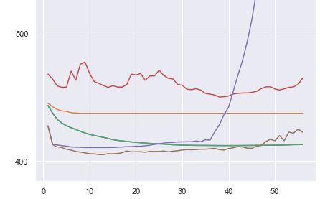
Modeling
Step 5: Conducting Feature Selection
MSE SCORE WITH THE CHANGE OF FEATURES
LR | Lasso | Ridge
39 | 9 | 39
kNN | Tree | XGBoost
38 | 10 | 12
PERFORMANCE
LR | Lasso | Ridge | kNN | Tree | XGBoost
412.27 | 437.57 | 412.27 | 450.34 | 410.73 | 405.17
BUSINESS UNDERSTANDING
DATA UNDERSTANDING
DATA PREPARATION
MODELING
ECONOMIC IMPACT

Slide 19
Modeling
Step 6: Hyperparameter Tuning Our Models
PARAMETERS
Lasso | alpha=0.001
Ridge | alpha=0.001
kNN | n_neighnors=45
Tree | max_depth=15, min_samples_leaf=3, min_impurity_decrease=0.005
XGBoost | max_depth=10, n_estimators=25, learning_rate=0.1
PERFORMANCE
LR | Lasso | Ridge | kNN | Tree | XGBoost
412.27 | 422.89 | 412.27 | 421.24 | 410.47 | 396.49
BUSINESS UNDERSTANDING
DATA UNDERSTANDING
DATA PREPARATION
MODELING
ECONOMIC IMPACT

Slide 20
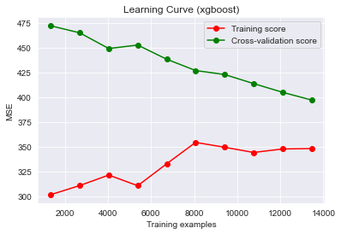
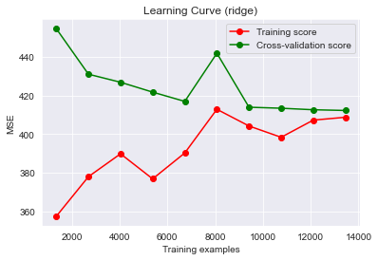
Modeling
Evaluating Our Final Model
IMPORTANT FEATURES
LEARNING CURVE
DEP_TIME_BLK
CRS_ELAPSED_TIME
MONTH
DAY_OF_WEEK
DEP_TIME_BLK
NUMBER_OF_SEATS
PLANE_AGE
FLIGHT_BLK_NUM
WT01 WT02 WT03
WT04 WT05 WT08
AWND PRCP
SNOW SNWD
TAVG TMAX TMIN
WSF2 WSF5
XGBoost
DEP_TIME_BLK
CRS_ELAPSED_TIME
MONTH
DAY_OF_WEEK
DEP_TIME_BLK
NUMBER_OF_SEATS
PLANE_AGE
FLIGHT_BLK_NUM
WT01 WT02 WT03
WT04 WT05 WT08
AWND PRCP
SNOW SNWD
TAVG TMAX TMIN
WSF2 WSF5
Ridge Regression
BUSINESS UNDERSTANDING
DATA UNDERSTANDING
DATA PREPARATION
MODELING
ECONOMIC IMPACT

Slide 21
Modeling
Evaluating Our Final Model
IMPORTANT FEATURES
LEARNING CURVE
M_8 M_9
WT01 WT02 WT03
WT04 WT05 WT08
AWND PRCP
SNOW SNWD
TAVG TMAX TMIN
WSF2 WSF5
DEP_TIME_BLK
CRS_ELAPSED_TIME
MONTH
DAY_OF_WEEK
DEP_TIME_BLK
NUMBER_OF_SEATS
PLANE_AGE
FLIGHT_BLK_NUM
BLK_0600-0659
BLK_0800-0859
BLK_1000-1059
BLK_1100-1159
MONTH
DAY_OF_WEEK
DEP_TIME_BLK
NUMBER_OF_SEATS
PLANE_AGE
FLIGHT_BLK_NUM
WT01 WT02 WT03
WT04 WT05 WT08
AWND PRCP
SNOW SNWD
TAVG TMAX TMIN
WSF2 WSF5
DEP_TIME_BLK
CRS_ELAPSED_TIME
M_6 M_7
BLK_2300-2359
BLK_2000-2059
BLK_1800-1859
BLK_1800-1959
BUSINESS UNDERSTANDING
DATA UNDERSTANDING
DATA PREPARATION
MODELING
ECONOMIC IMPACT

Slide 22
Modeling
Evaluating Our Final Model
IMPORTANT FEATURES
LEARNING CURVE
M_8 M_9
WT01 WT02 WT03
WT04 WT05 WT08
AWND PRCP
SNOW SNWD
TAVG TMAX TMIN
WSF2 WSF5
DEP_TIME_BLK
CRS_ELAPSED_TIME
MONTH
DAY_OF_WEEK
DEP_TIME_BLK
NUMBER_OF_SEATS
PLANE_AGE
FLIGHT_BLK_NUM
BLK_0600-0659
BLK_0800-0859
BLK_1000-1059
BLK_1100-1159
MONTH
DAY_OF_WEEK
DEP_TIME_BLK
NUMBER_OF_SEATS
PLANE_AGE
FLIGHT_BLK_NUM
WT01 WT02 WT03
WT04 WT05 WT08
AWND PRCP
SNOW SNWD
TAVG TMAX TMIN
WSF2 WSF5
DEP_TIME_BLK
CRS_ELAPSED_TIME
M_6 M_7
WT01: Fog
WT02: Heavy fog
WT03: Thunder
WT05: Hail
PRCP: Precipitation
SNWD: Snow depth
BLK_2300-2359
BLK_2000-2059
BLK_1800-1859
BLK_1800-1959
BUSINESS UNDERSTANDING
DATA UNDERSTANDING
DATA PREPARATION
MODELING
ECONOMIC IMPACT

Slide 23
Modeling
Evaluating Our Final Model
IMPORTANT FEATURES
LEARNING CURVE
M_8 M_9
WT01 WT02 WT03
WT04 WT05 WT08
AWND PRCP
SNOW SNWD
TAVG TMAX TMIN
WSF2 WSF5
DEP_TIME_BLK
CRS_ELAPSED_TIME
MONTH
DAY_OF_WEEK
DEP_TIME_BLK
NUMBER_OF_SEATS
PLANE_AGE
FLIGHT_BLK_NUM
BLK_0600-0659
BLK_0800-0859
BLK_1000-1059
BLK_1100-1159
EVALUATIONS
PERFORMANCE ON TEST DATA
XGBoost is the best performing model for this project.
The lowest MSE score means that we can predict the delay with small error.
With more training data, we can get a better model with smaller error.
XGBoost performs well on small dataset, runs faster, and prevents overfitting.
With final model, the score of the
model prediction on test data,
(2019-11 and 2019-12) is:
MSE 249, RMSE 17
BUSINESS UNDERSTANDING
DATA UNDERSTANDING
DATA PREPARATION
MODELING
ECONOMIC IMPACT

Slide 24
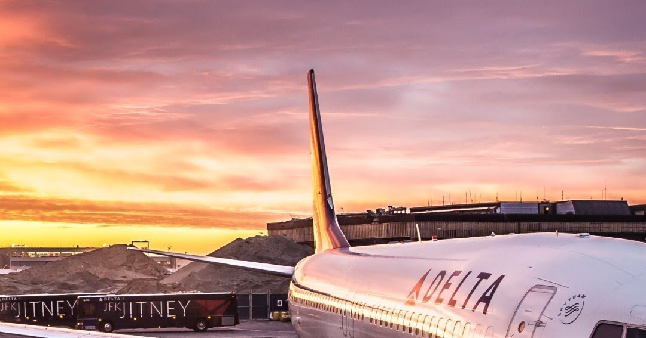
5
ECONOMIC IMPACT

Slide 25
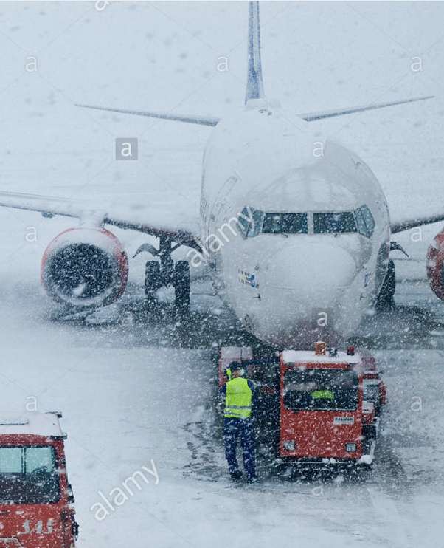


Economic Impact
Model Deployment: Identifying the Top Influencers of Flight Delays
1
2
3
MONTH
6, 7
DEP_TIME_BLK
1800-2359
SNOW, SNWD & PRCP
Inevitable flight delays due to nature
Higher air traffic due to summer month vacations.
Domino effect of delays throughout the day
BUSINESS UNDERSTANDING
DATA UNDERSTANDING
DATA PREPARATION
MODELING
ECONOMIC IMPACT
Notes:
Reallocate delta's planes, assets & staff to accommodate for these delay reasons

Slide 26
ECONOMIC IMPACT
The Predictive Model Will Help Determine How Delayed a Delta Flight Will Be at the Atlanta Airport
Impact on Delta
Impact on Airport
Retain the ~1.53B in costs associated with flight delays
Includes flight compensations, crew expenses, fuel and maintenance, etc.
Earn additional revenue of ~719M from increased demand & loyal customers that enjoy convenient departure times
Increase revenues from businesses that choose to send their employees on business travels through Delta because of low delay rate and higher on time arrival
Atlanta Airport can better arrange gates and ground/runway staff for incoming flights to land by considering departure delays for current flights
Save Costs for Customers
Delta customers would collectively save ~$3B in costs associated with flight delays
This includes expenses for food & accommodations as a result of being away from home
BUSINESS UNDERSTANDING
DATA UNDERSTANDING
DATA PREPARATION
MODELING
ECONOMIC IMPACT
Notes:
Source: Flight delays cost more than just time - Berkeley Engineering
Flight Delays in Numbers - Not Only Painful For Passengers - All Things On Time Performance

Slide 27
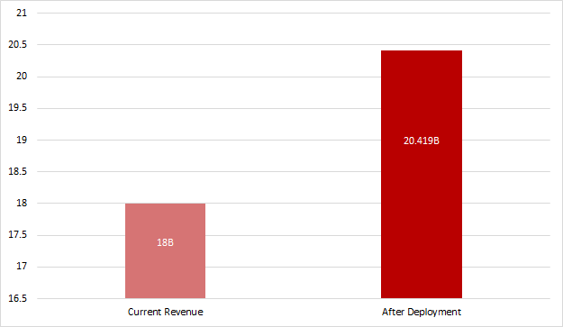
ECONOMIC IMPACT
Impact on Revenue
BUSINESS UNDERSTANDING
DATA UNDERSTANDING
DATA PREPARATION
MODELING
ECONOMIC IMPACT

Slide 28
ECONOMIC IMPACT
Deployment Risks & Mitigation
Weather is volatile and can change on the same day --> impacts accuracy of model
Model only considers weather for origin airport but not for entire flight route
mitigate with further data modeling with higher computational power
Model was not tested on COVID months flight data
mitigate with further data modeling incorporating COVID flight data
Ethical Consideration: Delta should not use our model as defense to avoid compensating customers who suffer financial/physical/emotional distress in case of inevitable flight departures (ie. weather, snow/rainstorm)
BUSINESS UNDERSTANDING
DATA UNDERSTANDING
DATA PREPARATION
MODELING
ECONOMIC IMPACT

Slide 29
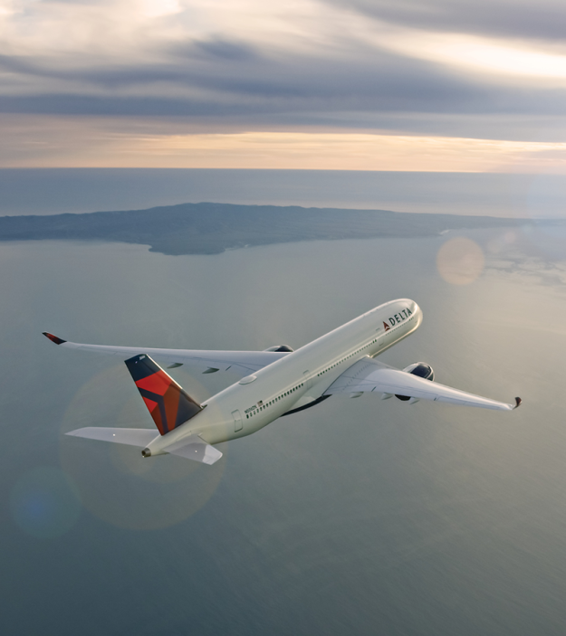
THANK YOU!
ANY QUESTIONS?

Slide 30
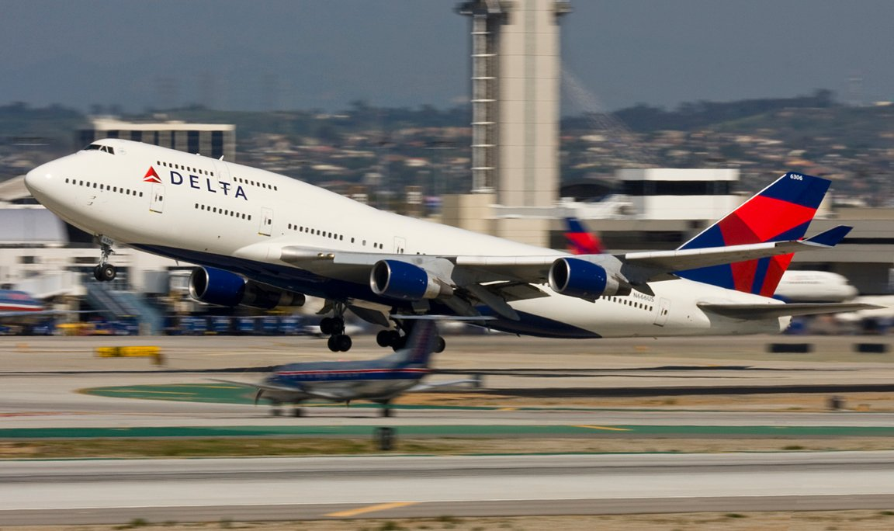
APPENDIX

Slide 31
Calculations/Assumptions for Economic Impact Numbers
Cost Component | Cost (in billions) *Inflation Adjusted (+0.23)* | Delta Airlines Costs (in billions)
Customers | $20.54 | $20.54 * 0.15 = $3.08
Airlines | $10.21 | $10.21 * 0.15 = $1.53
Airports / GDP | $4.92 | N/A
Total | $40.46 | $4.61

Slide 32
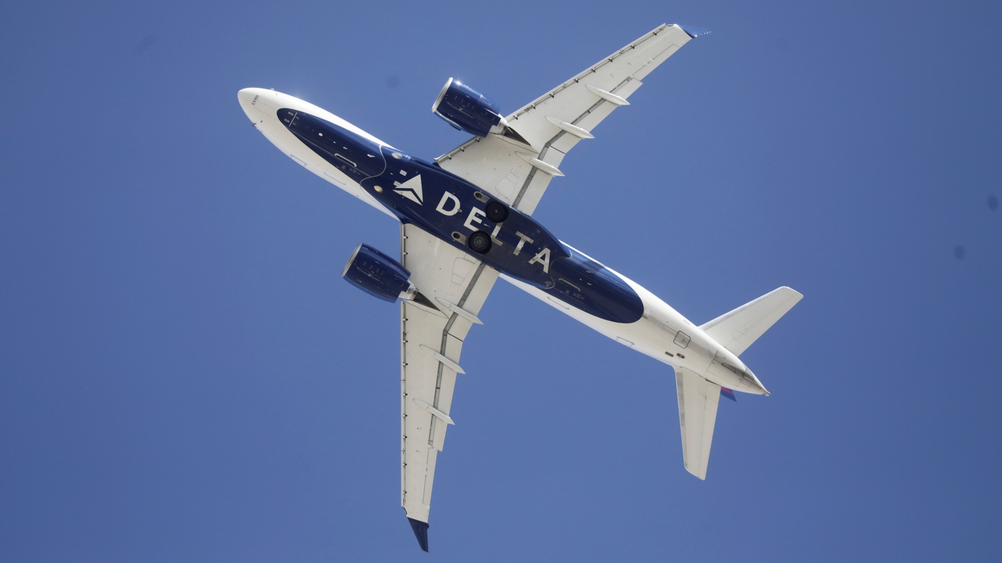
BIBLIOGRAPHY

Slide 33
BIBLIOGRAPHY
https://journalofbigdata.springeropen.com/articles/10.1186/s40537-020-00380-z
https://www.kaggle.com/threnjen/2019-airline-delays-and-cancellations
https://www.travelinc.com/impact-of-flight-disruptions/
https://digital.hbs.edu/platform-rctom/submission/delta-airlines-flying-high-in-a-competitive-industry/
https://engineering.berkeley.edu/news/2010/11/flight-delays-cost-more-than-just-time/
https://www.allthingsontimeperformance.com/flight-delays-in-numbers-not-only-painful-for-passengers/

